Slide 1
Decision Tree Analysis to Predict Food Sources of Shiga Toxin-Producing Escherichia coli (STEC) Outbreaks using Demographic and Outbreak Characteristics, United States, 1998-2014
Alice White, MS
Colorado Integrated Food Safety Center of Excellence
CSTE Annual Conference, Boise ID, June 2017
Notes:
Hi Everyone. I’m Alice White from the Colorado Integrated Food Safety Center of Excellence, and I will be presenting on…

Slide 2
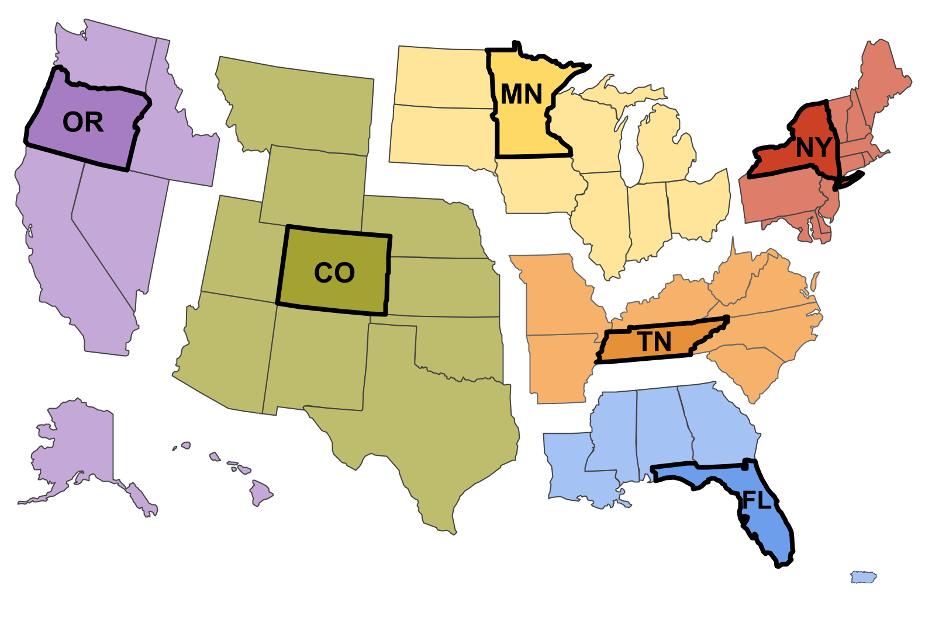

Integrated Food Safety Centers of Excellence (CoE)
Notes:
First, just a very brief background on the Integrated Food Safety Centers of Excellence, or CoEs. Elizabeth will go into more detail in the next presentation. Established in 2012, there are 6 CoEs, each of which is associated with a region and is a partnership between a state health department and an academic institution.

Slide 3
CoE Mission
Build capacity in local and state health departments by developing and providing online and in-person resources, training, and assistance for foodborne illness surveillance and investigations
Notes:
The overall goal of the CoEs is to…

Slide 4
Unsolved Outbreaks
Outbreak investigations identify food safety interventions
Pathogen, food, contributing factors
Identifying food vehicle is critical
42% of outbreaks do not confirm food vehicle
Notes:
An area of focus for the CoEs has been on unsolved outbreaks. As we all know, investigation findings help identify food safety interventions to prevent future illness and outbreaks by identifying pathogens and foods causing illness and the factors contributing to food contamination. Key to impacting food safety is identifying a food vehicle. However, nearly half of outbreaks don’t identify a food.
In order to identify a food vehicle, you need to be able to test a hypothesis, however you can’t test a hypothesis without generating a good one. So how do you generate a good hypohthesis?

Slide 5
Example
Demographics – STEC O157 Outbreak
Age, median (range) | 24 (4-66)
Gender, n (%)
Female | 21 (64%)
Male | 12 (36%)
Notes:
33 cases
Multistate
2012
Young women – and even with this small amount of information, some of you may already be hypothesizing in your heads…

Slide 6

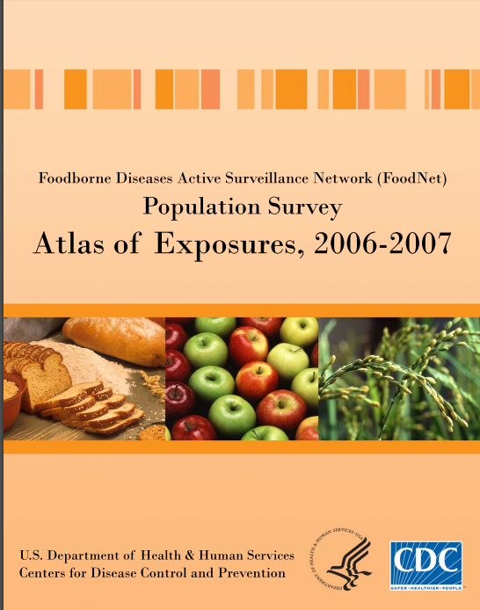

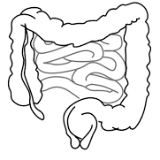
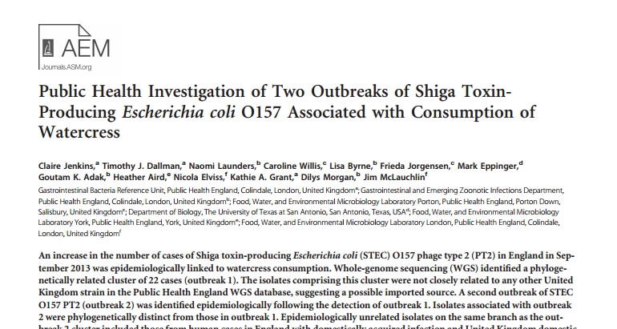
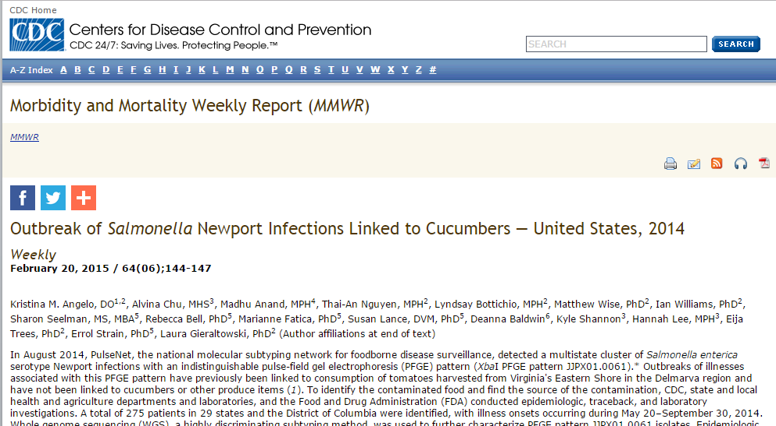

Slide 7
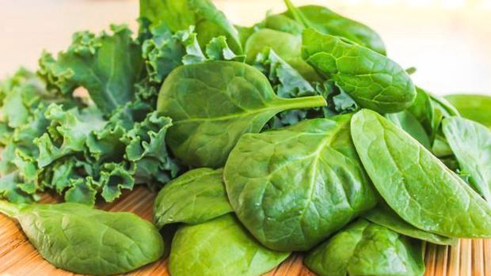
Notes:
So leafy greens was the culprit in this outbreak, which may have crossed some of your minds given the demographics. We wanted to know, if we look at all past outbreaks, are demographics a good indicator?
BUT not everyone may have these resources easily accessible, especially the inistitutional knowledge and experience, so we started thinking about developing tools

Slide 8
Project Purpose
Use existing outbreak data to develop methods and tools to make hypotheses about food vehicles
Used STEC outbreaks to describe differences in demographic and outbreak characteristics and predict food vehicles using differential characteristics
Notes:
So we started thinking about how can we take some of this institutional knowledge and turn it into a tool? The purpose of this project was to use existing outbreak data…

Slide 9
Methods
Data source
Electronic Foodborne Outbreak Reporting System (eFORS), 1998-2008
National Outbreak Reporting System (NORS), 2009-2014
Food source categories
Interagency Food Safety Analytics Collaboration (IFSAC) Food Categorization Scheme
Predictors
Percent female, percent hospitalized, percent age categories (< 5 years, 5-19, 20-49, >50), multistate exposure, setting (private or non-private), season, duration

Slide 10
Results
STEC Outbreaks, 1998-2014 (n=470)
Undetermined food (n=153)
Complex foods (n=80)
Rare foods (n=31)
Non-O157:H7 (n=15)
119 BEEF
25 DAIRY
39 LEAFY GREENS

Slide 11
Univariate Results
Predictor | Beef | Dairy | Leafy | P value
Gender *
% Female | 50 (34-70) | 50 (33-67) | 64 (56-74) | 0.009
Age (years) *
% <5 | 0 (0-13) | 22 (0-33) | 0 (0-4) | 0.014
% 5-19 | 35 (12-61) | 50 (50-67) | 20 (15-33) | 0.017
% 20-49 | 21 (0-33) | 17 (0-33) | 44 (30-54) | <0.001
% >50 | 14 (0-33) | 0 (0-0) | 19 (9-40) | 0.002
Cases * | 9 (3-17) | 5 (3-9) | 18 (10-33) | <0.001
* Data presented as median (IQR), p value from Kruskal-Wallis
Notes:
-The median percent female was 50% for beef and dairy, and 65% for leafy outbreaks
-The median percentage age under 5 and age 5-19 were highest for dairy outbreaks
-Age 20-49 was highest for leafy outbreaks
-Age greater than 50 was similar for beef and leafy outbreaks, and low for dairy outbreaks
-The average number of ill cases was highest for leafy outbreaks, with a median of 18 cases

Slide 12
Univariate Results
Predictor | Beef | Dairy | Leafy | P value
Setting† |  |  |  | <0.001
Private Home | 45 (52%) | 14 (70%) | 5 (13%)
Non-private | 33 (38%) | 4 (20%) | 32 (82%)
Multistate Exposure† | 31 (36%) | 2 (10%) | 22 (56%) | 0.002
Season‡ |  |  |  | 0.108
Fall | 17 (20%) | 7 (35%) | 17 (44%)
Spring | 28 (33%) | 6 (30%) | 8 (21%)
Summer | 34 (40%) | 6 (30%) | 9 (23%)
Winter | 7 (8%) | 1 (5%) | 5 (13%)
† Presented as proportion (%), p value from Chi-square ‡ Presented as proportion (%), Fisher’s Exact
Notes:
-Beef and dairy outbreaks occurred more often in a private home, whereas leafy outbreaks occurred more often in a non-private setting
-Leafy outbreaks were more likely to be multistate
-Leafy outbreaks were most likely to occur in fall
Beef outbreaks were most likely to occur in the summer months

Slide 13
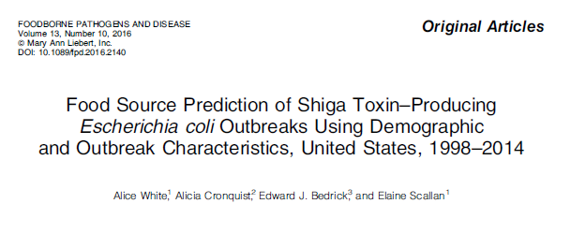

Slide 14
STEC O157:H7 outbreak
Cases 20-49 years < 33%?
yes
no
Cases under 5 years < 10%?
Cases under 5 years < 17%?
yes
no
Is the season fall?
BEEF
Cases under 5 years < 68%?
no
yes
no
yes
yes
no
Female cases < 63%?
Cases under 5 years < 39%?
BEEF
LEAFY GREENS
yes
no
yes
no
BEEF
LEAFY GREENS
BEEF
DAIRY
DAIRY

Slide 15
STEC outbreak
STEC O157:H7 outbreak
Cases 20-49 years < 33%?
Cases 20-49 years < 33%?
yes
no
yes
Cases under 5 years < 10%?
Cases under 5 years < 17%?
Cases under 5 years < 10%?
yes
no
yes
Is the season fall?
BEEF
Cases under 5 years < 68%?
Is the season fall?
BEEF
no
yes
no
no
yes
yes
no
yes
Female cases < 63%?
Cases under 5 years < 39%?
BEEF
LEAFY GREENS
Female cases < 63%?
yes
no
yes
no
yes
no
BEEF
LEAFY GREENS
BEEF
DAIRY
DAIRY
BEEF
LEAFY GREENS

Slide 16
Decision Tree Results
 |  | OBSERVED OUTCOME
PREDICTED OUTCOME |  | Beef | Dairy | Leafy | Overall | Precision (%)
 | Beef | 109 | 13 | 19 | 141 | 77
 | Dairy | 4 | 10 | 1 | 15 | 67
 | Leafy | 6 | 2 | 19 | 27 | 70
 | Overall | 119 | 25 | 39
 | Sensitivity (%) | 92 | 40 | 49
 | Specificity (%) | 50 | 97 | 94

Slide 17
Discussion
Pathogen & serotype are the best predictors of a food vehicle
Demographic data (age & gender) and season can provide some discrimination between vehicles
Notes:
And even having a simple reference for pathogen, serotype and most frequent foods is useful. The NORS team

Slide 18
Discussion
Limitations
Known sources of STEC illness
Future directions
Prospective validation
Develop tools
Other major pathogens

Slide 19
Acknowledgments
Co-authors
Kayla Bell, Colorado School of Public Health
Elaine Scallan, PhD, Colorado School of Public Health
NORS team at CDC

Slide 20
www.COFoodSafety.org
alice.white@ucdenver.edu
(303) 724-9319

